Slide 1

Project Title – AIRBNB HOTEL BOOKING ANALYSIS
VOIS AICTE Internship (Oct 2025)
Tuhin Kumar Singha Roy
INTERNSHIP- INTERNSHIP_17546440516895be537820f

Slide 2

PROBLEM STATEMENT
The hospitality industry has undergone a significant transformation with the rise of online platforms facilitating short-term lodging and tourism. Leading this revolution is Airbnb, Inc., a pioneering American company that has reshaped travel accommodation through its innovative online marketplace. Established in 2008 in San Francisco, California, Airbnb provides a diverse range of lodging options, offering guests a unique and personalized experience. Unlike traditional hospitality providers, Airbnb operates on a commission-based model, facilitating transactions between hosts and guests without owning the properties listed on its platform.
This research analysis delves into the New York City Airbnb dataset to extract meaningful insights. Through rigorous data cleaning, exploratory analysis, and visualization techniques, the study aims to illuminate the dynamics of the city's lodging market. By discerning factors influencing listing availability, pricing strategies, and overall customer satisfaction, the research contributes to a deeper understanding of Airbnb's operations in one of the world's most dynamic urban environments. These insights hold significance for stakeholders and enthusiasts seeking to navigate the evolving landscape of short-term accommodation

Slide 3
Project Description 1
1
Objective: Analyze the New York City Airbnb dataset to understand pricing trends, availability, and customer behavior, and to build a machine learning model for predicting listing prices.
2
Data Cleaning & Preprocessing:
Removed irrelevant and high-missing-value columns.
Converted price column into numeric format.
Handled missing values using median (numeric), mode (categorical), and zeros (reviews_per_month).
Treated outliers using the IQR method and dropped duplicates.
Engineered new features:
distance_from_center (from latitude & longitude)
estimated_active_months (reviews ÷ reviews_per_month).
3
Exploratory Data Analysis (EDA):
Price distribution was highly skewed; normalized using log transformation.
Entire homes/apartments were the most expensive, while private/shared rooms were cheaper.
Neighborhoods significantly influenced pricing, with premium areas showing higher costs.
Seasonal demand observed in availability trends, but weak correlation with price.
Correlation analysis revealed location, room type, and reviews as strongest predictors.
Geospatial visualization mapped listings across NYC.

Slide 4
Project Description 2
4
Machine Learning Approach:
Applied One-Hot Encoding for categorical features.
Train/Test split of 80/20 for model evaluation.
Trained Linear Regression (baseline) and Random Forest Regressor.
Random Forest outperformed Linear Regression with higher accuracy (R²).
Important predictors: room type, neighborhood, number of reviews, availability.
5
Key Findings:
Location is the most important factor driving Airbnb prices.
Room type affects affordability and demand.
Reviews indicate customer trust and host activity.
Outcome: Built an end-to-end workflow from raw dataset → cleaning → EDA → predictive modeling, with Random Forest as the best-performing model.
Future Scope:
Deployment
Perform neighborhood-level clustering for deeper insights.

Slide 5

WHO ARE THE END USERS?
Airbnb Hosts
Can use insights to set competitive and profitable pricing.
Understand how room type, location, and reviews affect demand.
Travelers/Guests
Can identify affordable neighborhoods.
Make informed booking decisions based on price, availability, and reviews.
Airbnb (the company)
Can optimize platform algorithms for pricing and recommendations.
Use demand patterns for strategic planning and marketing.
Hospitality & Tourism Analysts
Gain insights into the short-term rental market trends.
Compare Airbnb’s performance with traditional hospitality.
Researchers & Students
Can use the dataset and methodology as a case study for data science,
machine learning, and market analysis.

Slide 6






Technology Used
Dataset: NYC Airbnb Open Data Key features: price, room_type, neighborhood, number_of_reviews, availability, latitude & longitude
Python: Pandas, NumPy → data cleaning & manipulation
Visualization: Matplotlib, Seaborn, Plotly
Geospatial Mapping: Folium
Machine Learning: Scikit-learn (Linear Regression, Random Forest)

Slide 7
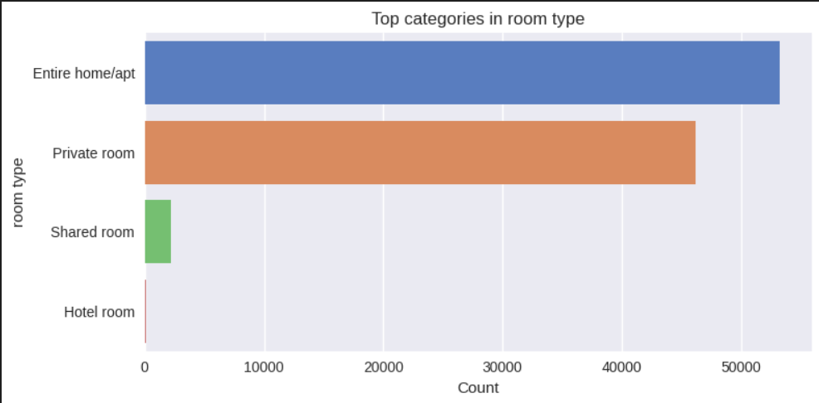
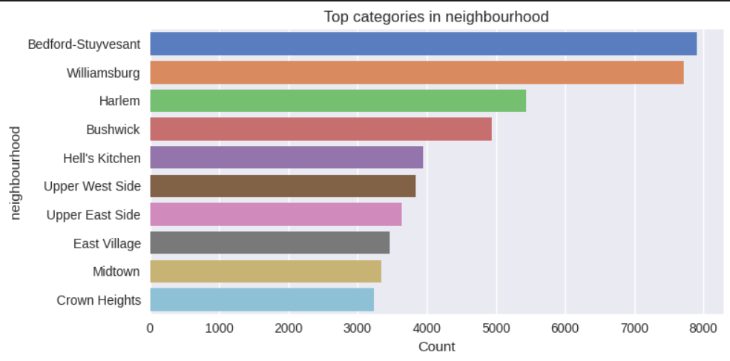
RESULTS 1

Slide 8
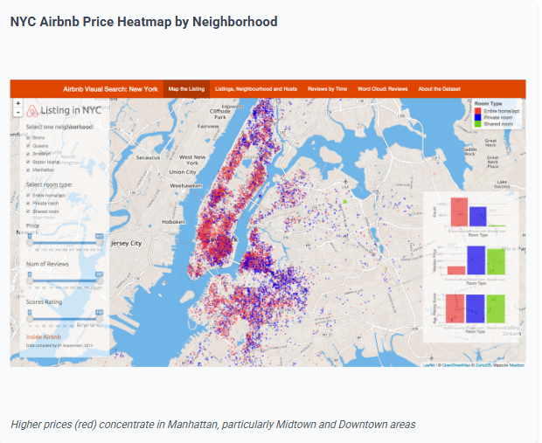
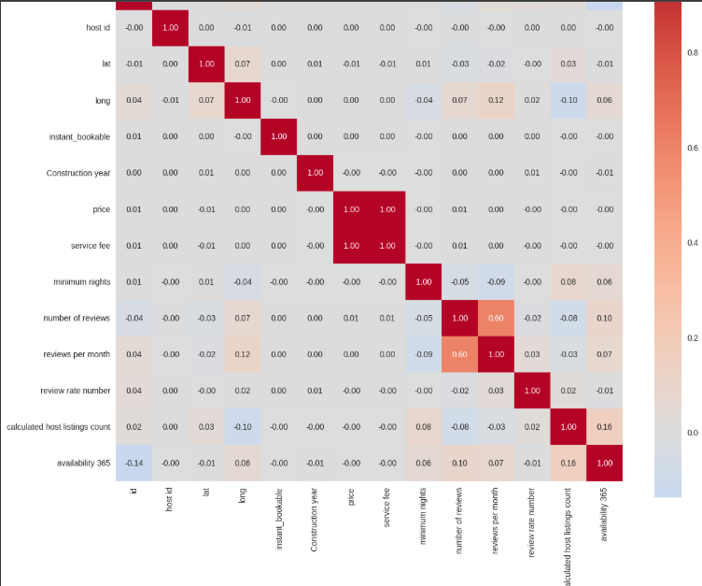
RESULTS 2

Slide 9

Github Repo
https://github.com/Tuhin108/VOIS_AICTE_OCT2025_TUHIN-KUMAR-SINGHA-ROY.git

Slide 10

Certificate 1

Slide 11

Certificate 2

Slide 12
Thank you!
.
.

